Slide 1
Apache Kafka

Slide 2


About me
Product Manager, Dashboard Analytics team at Syncfusion Software.
https://twitter.com/dinuswt22
https://github.com/dinesarun/common

Slide 3

Why Kafka?

Slide 4
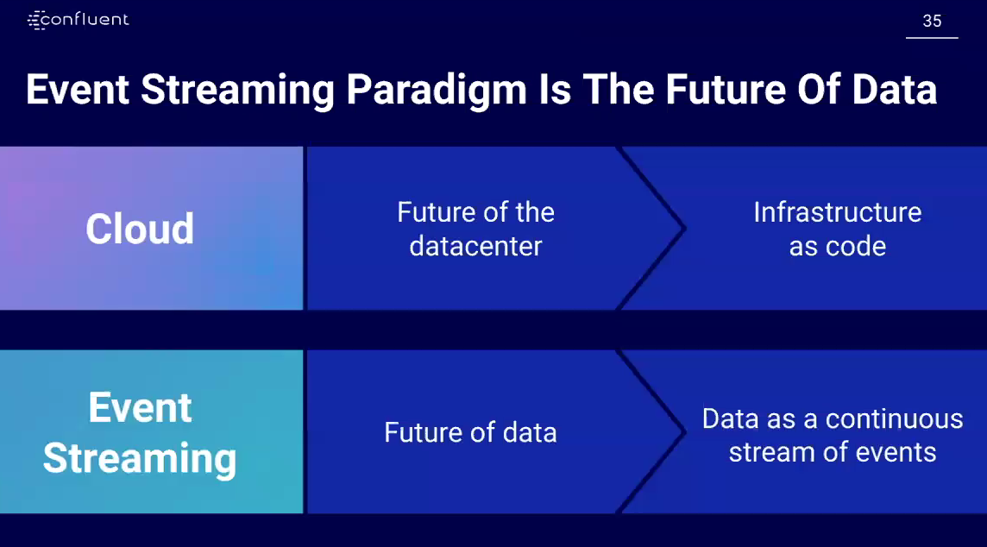

Slide 5
What is a Company?

Slide 6
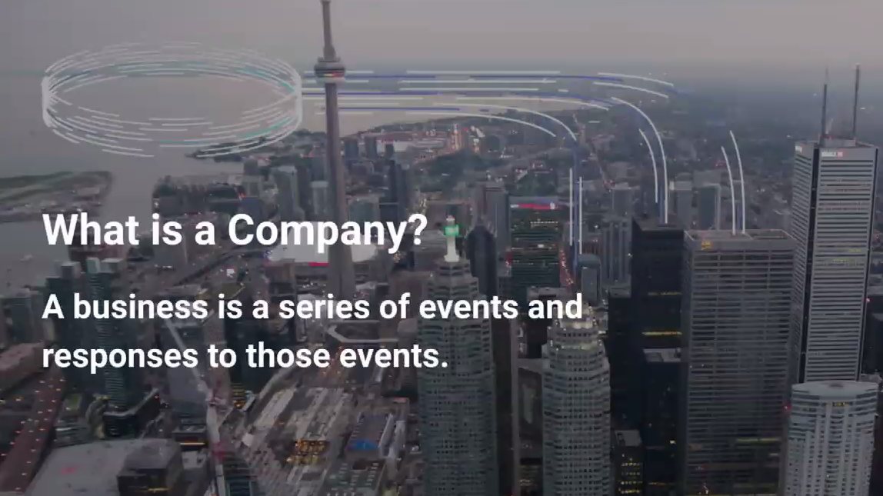

Slide 7


Slide 8


Slide 9
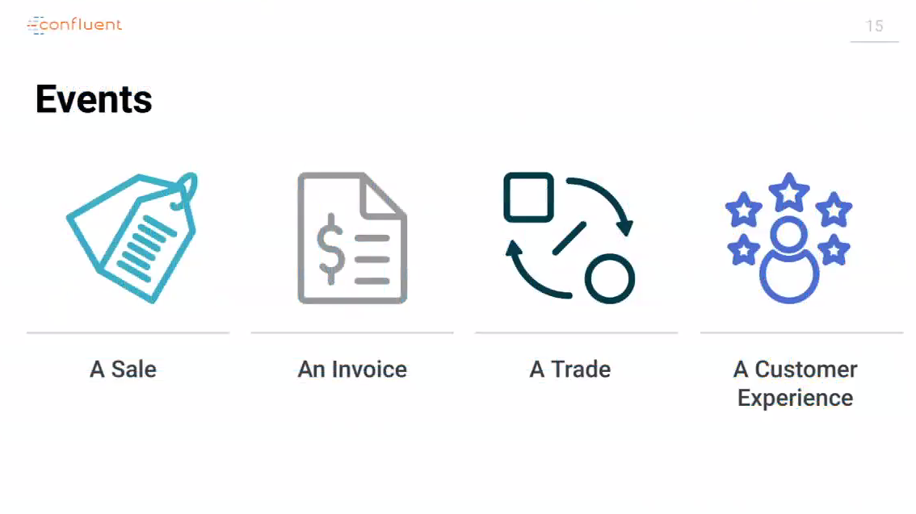

Slide 10
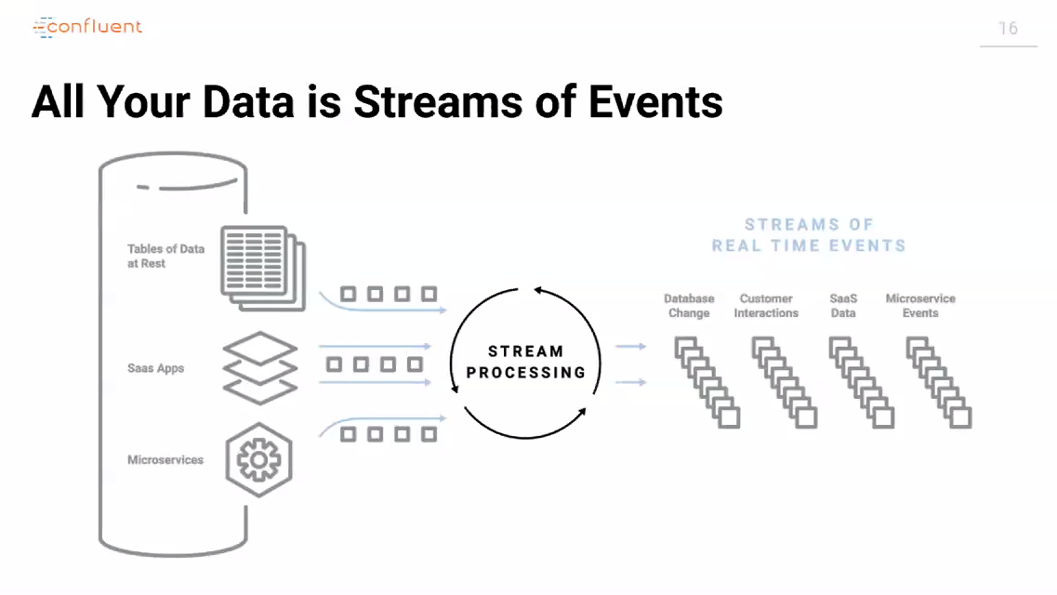

Slide 11
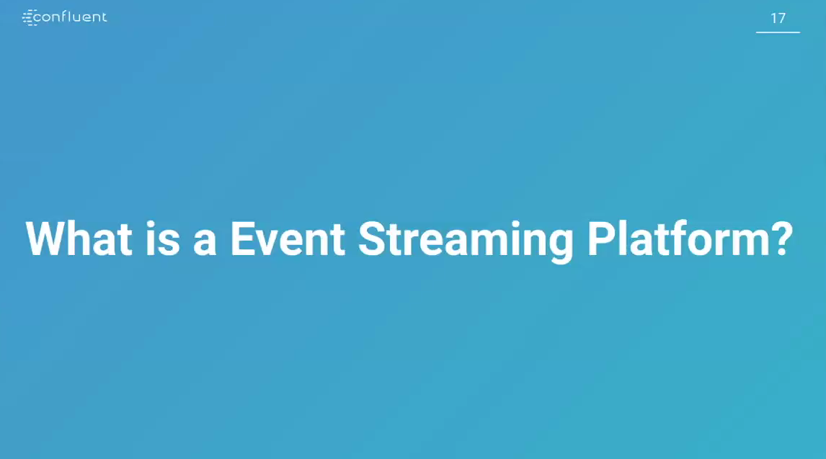

Slide 12
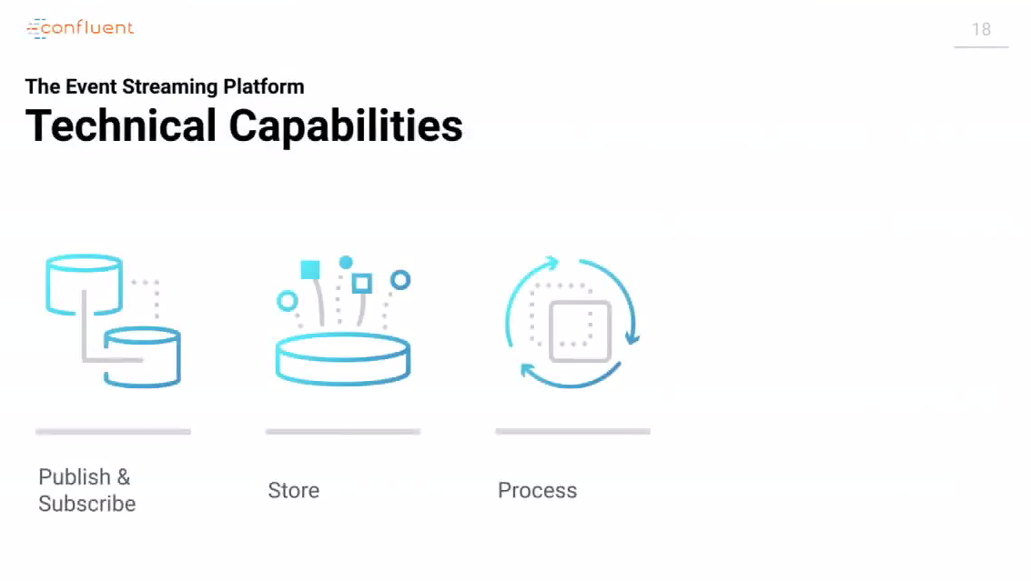

Slide 13
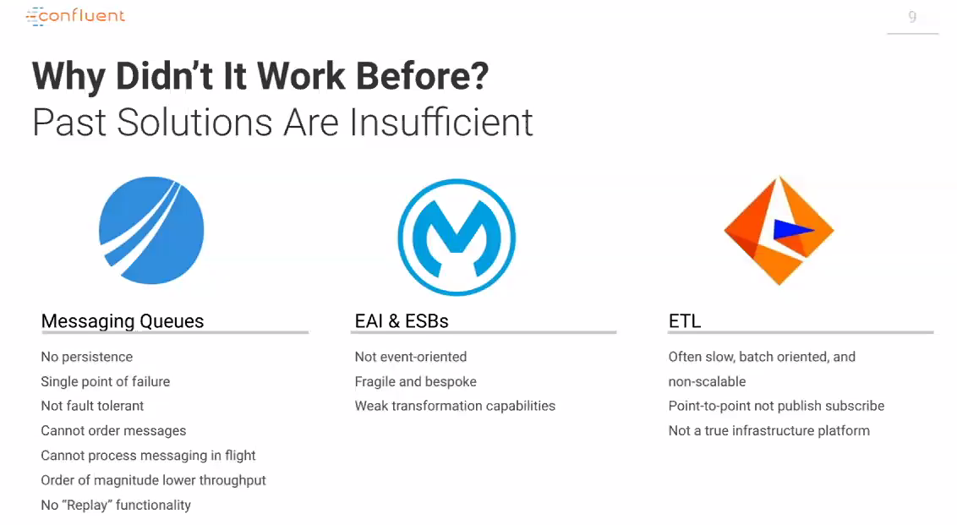

Slide 14
Why Kafka?

Slide 15


Slide 16
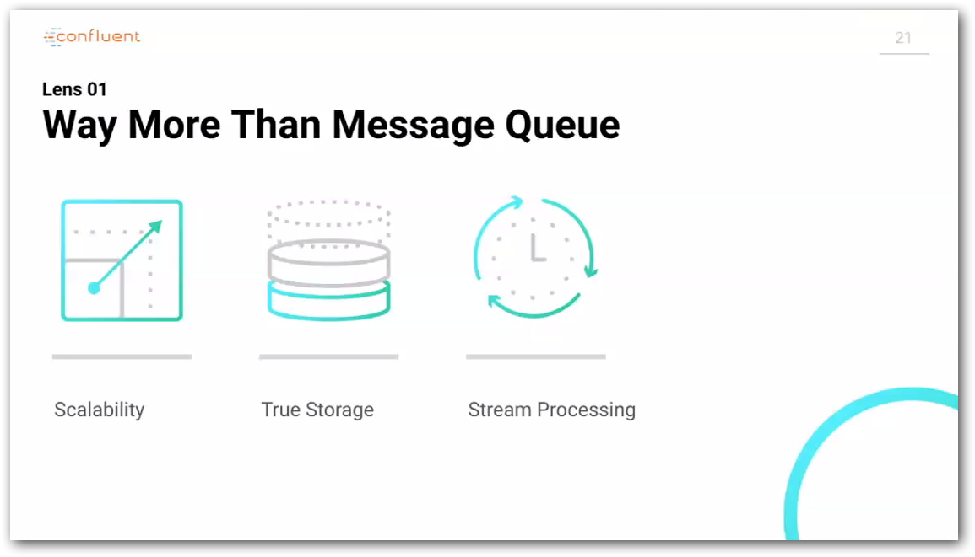

Slide 17
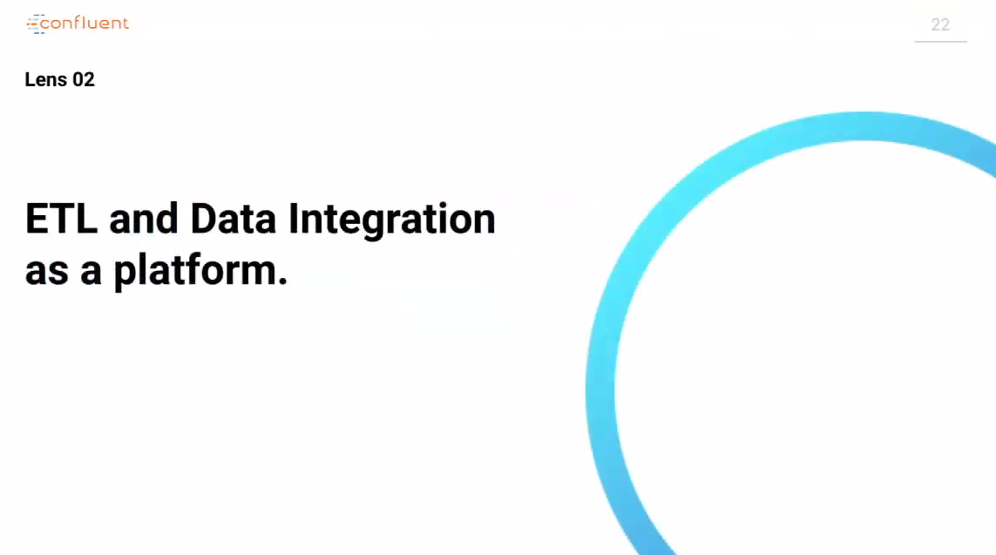

Slide 18
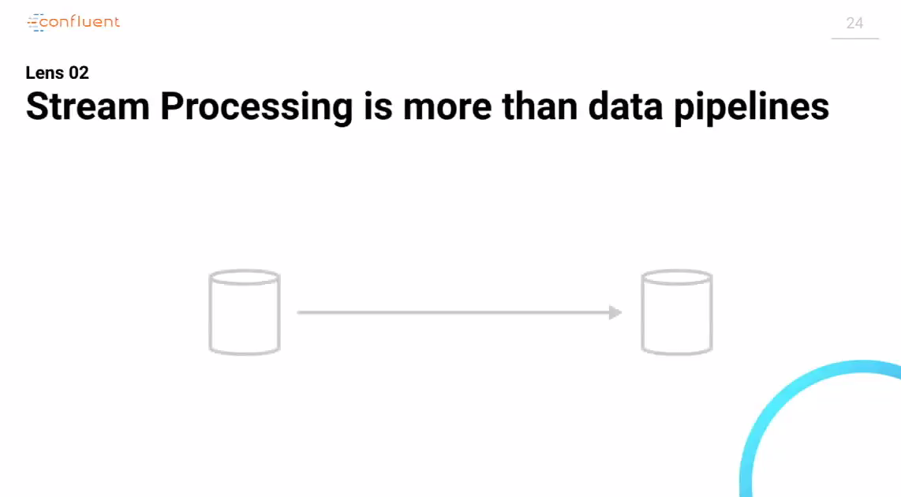

Slide 19
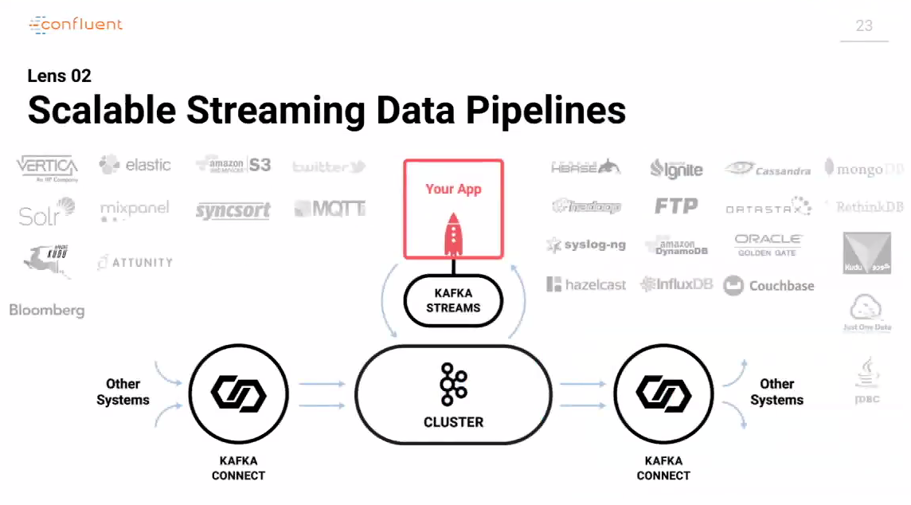

Slide 20
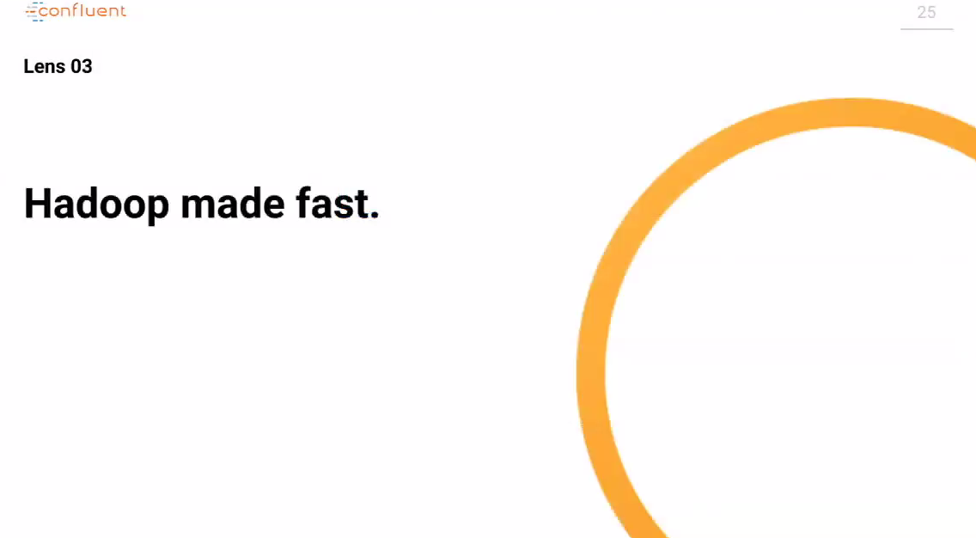

Slide 21
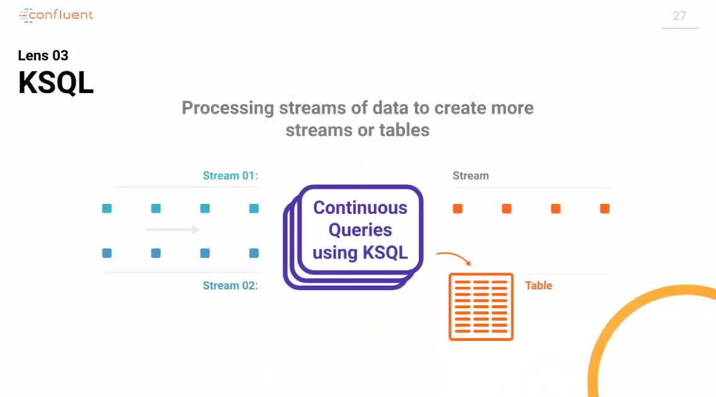

Slide 22
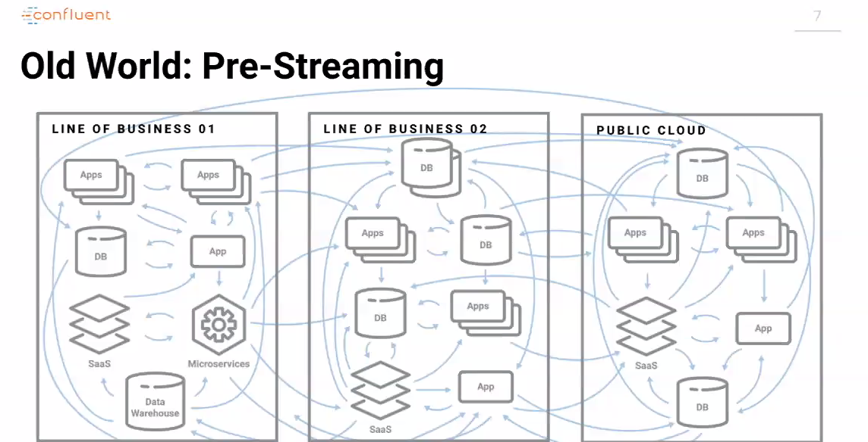

Slide 23
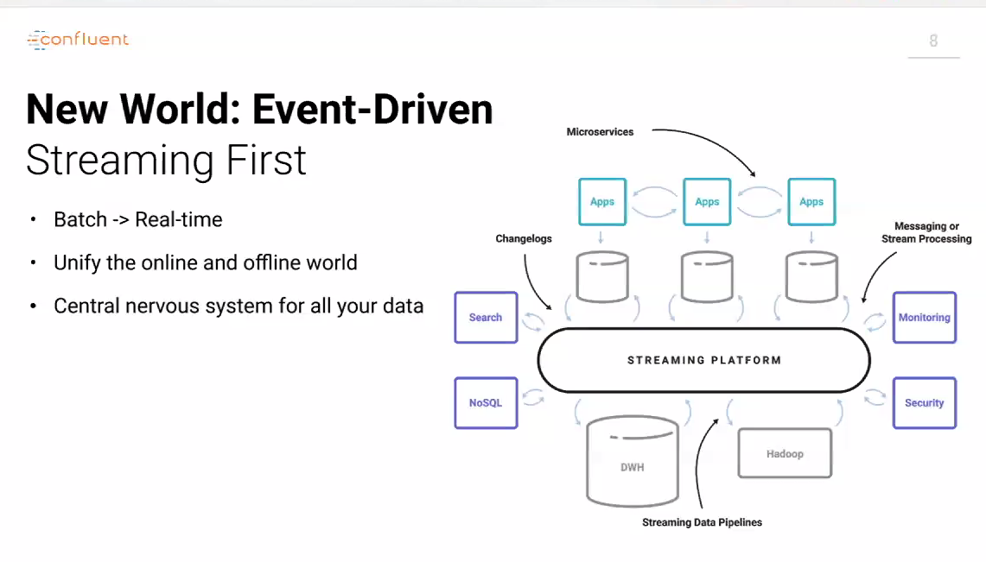

Slide 24
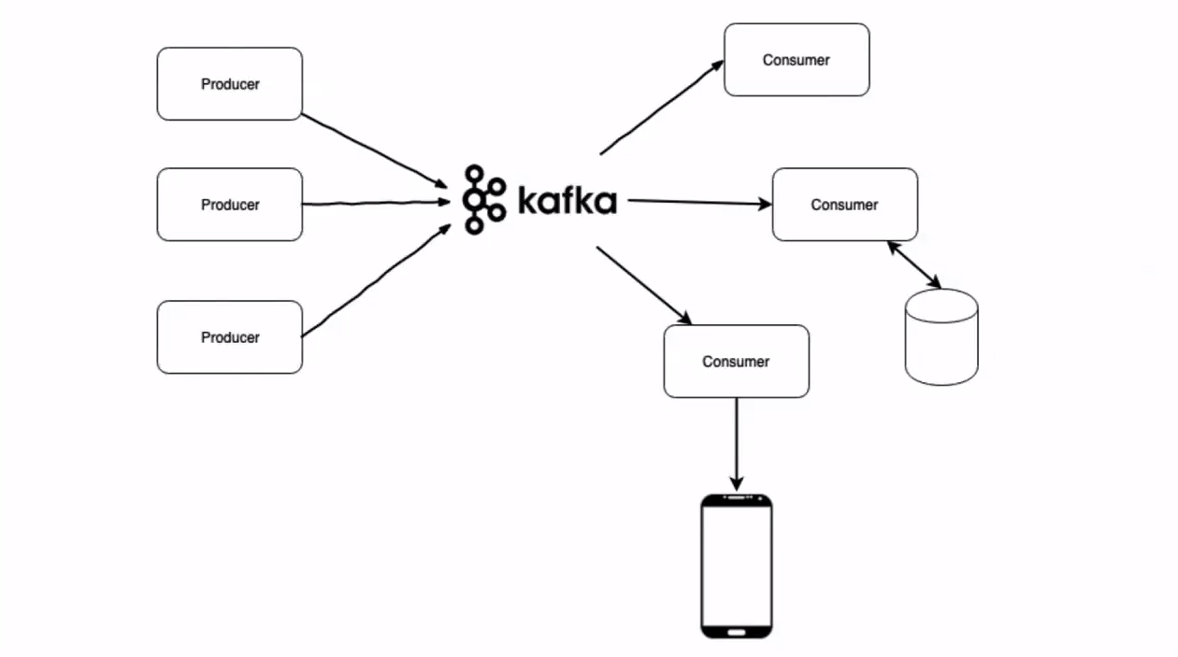
Apache Kafka

Slide 25

Architecture

Slide 26
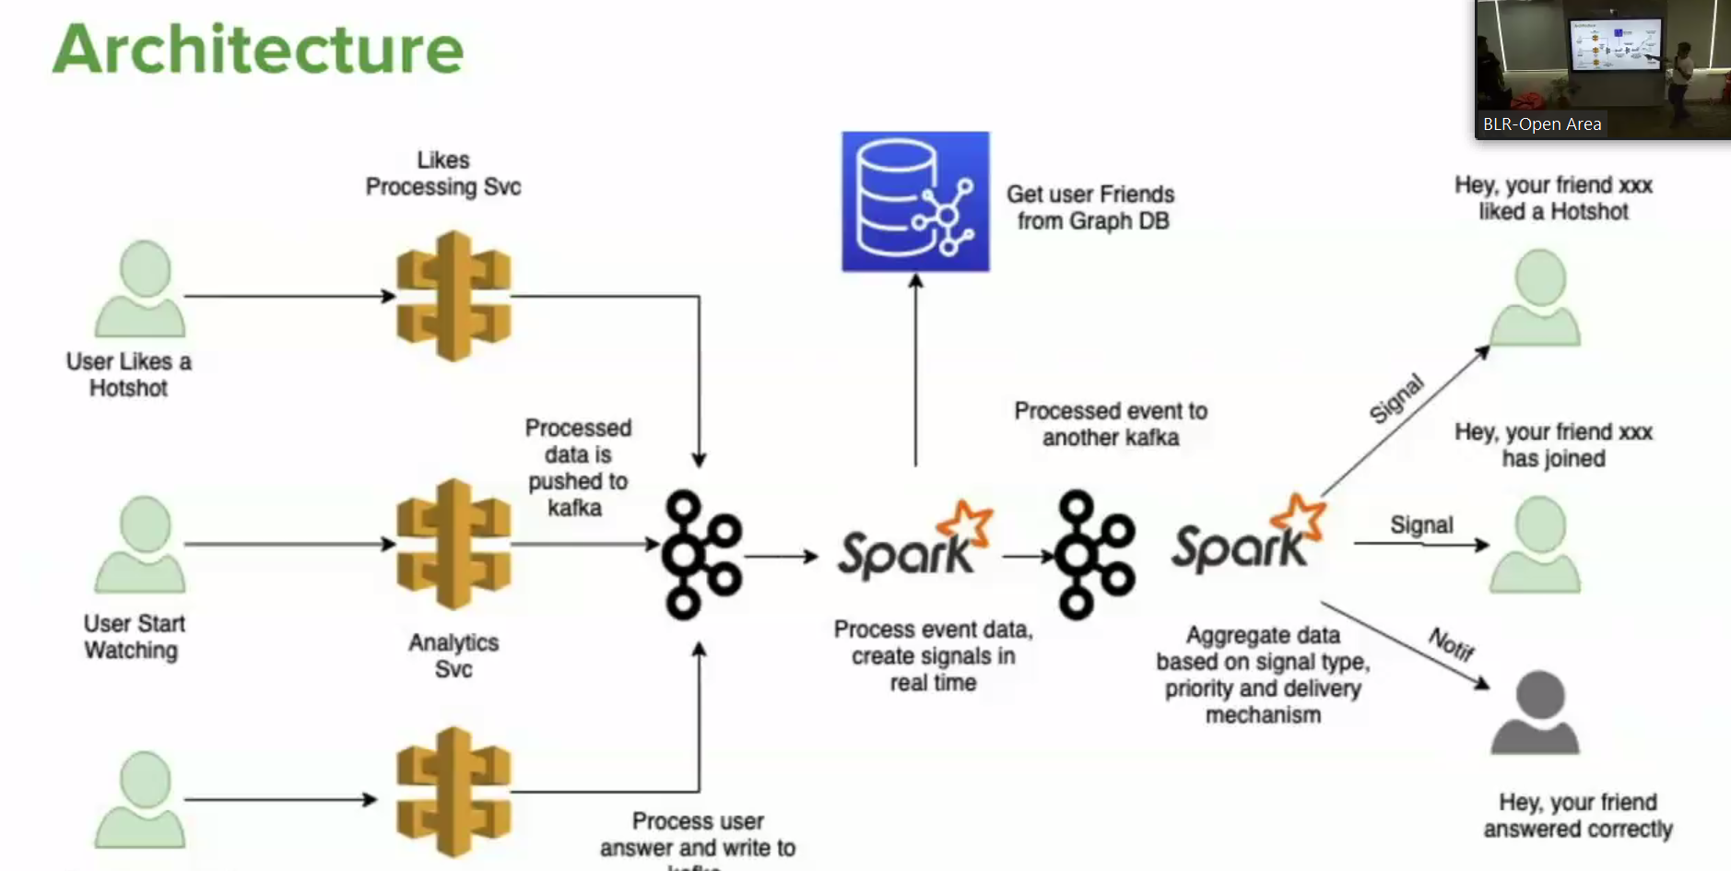
Hotstar

Slide 27
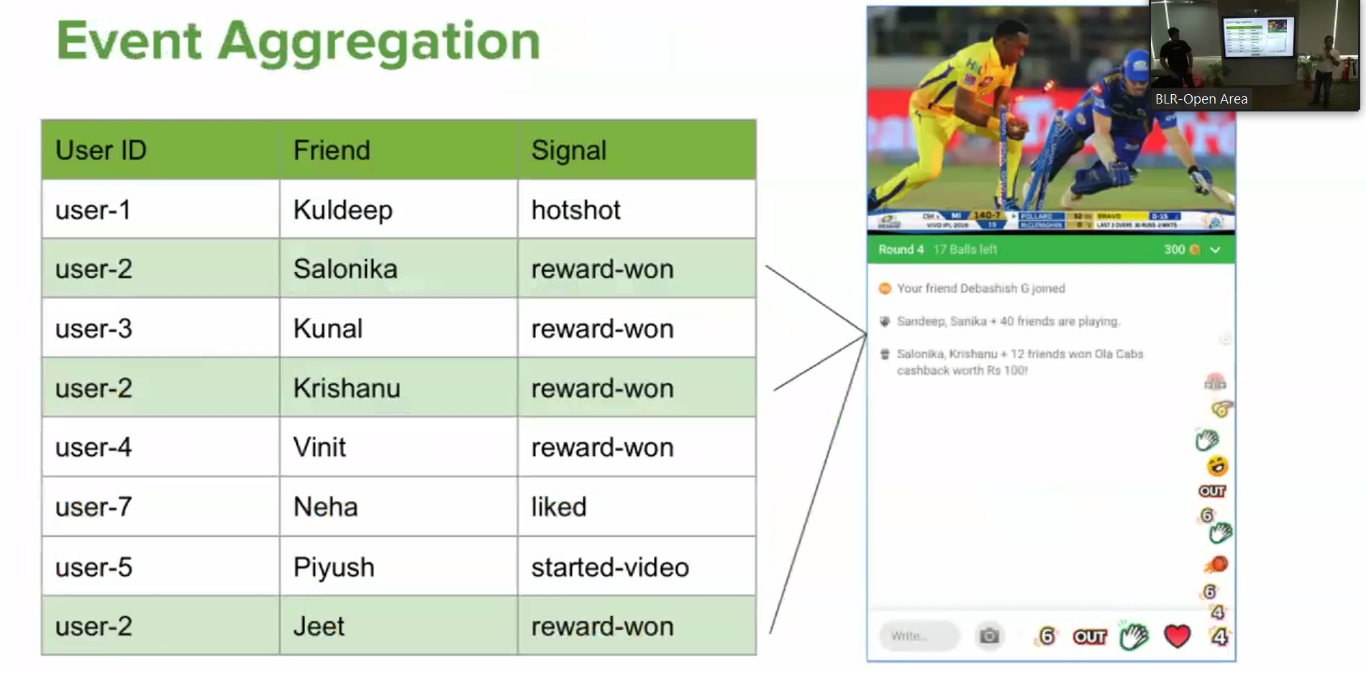

Slide 28
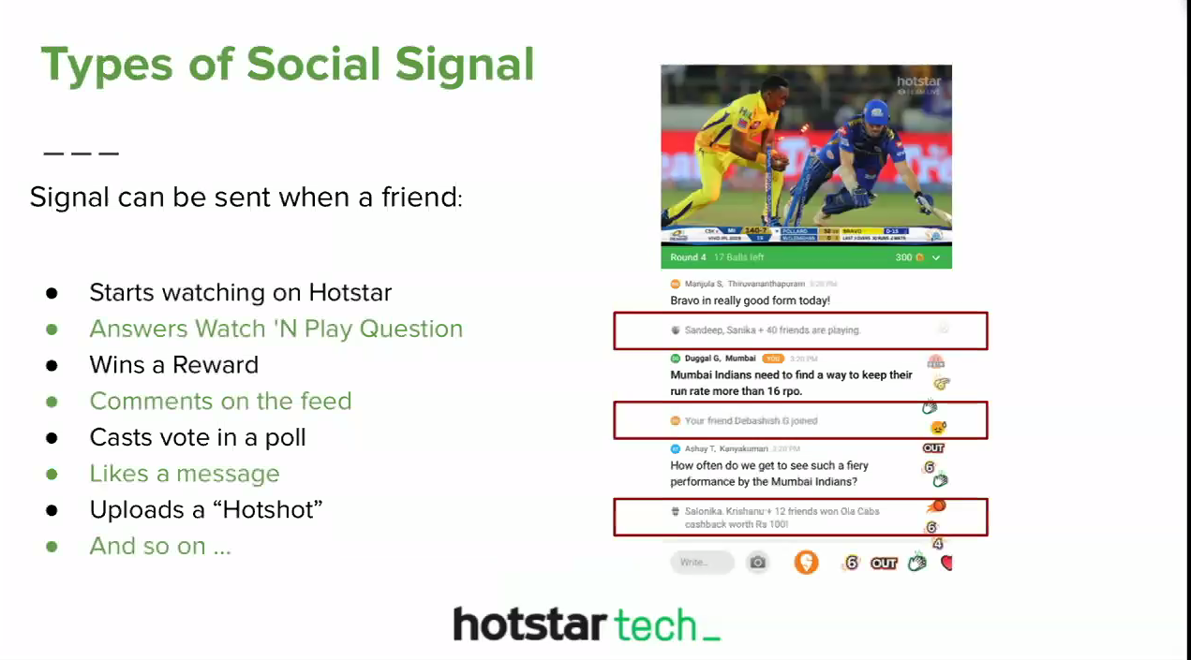

Slide 29
Use cases

Slide 30
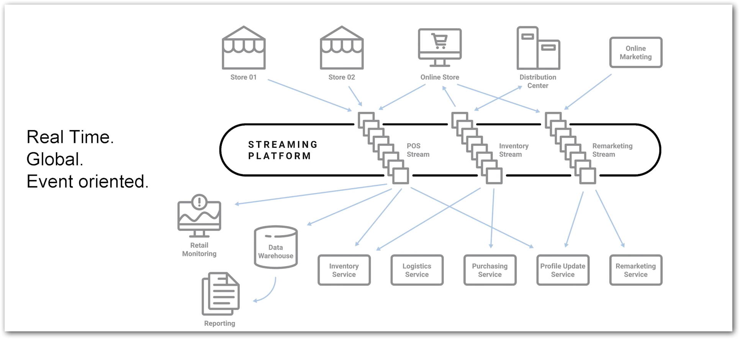

Slide 31
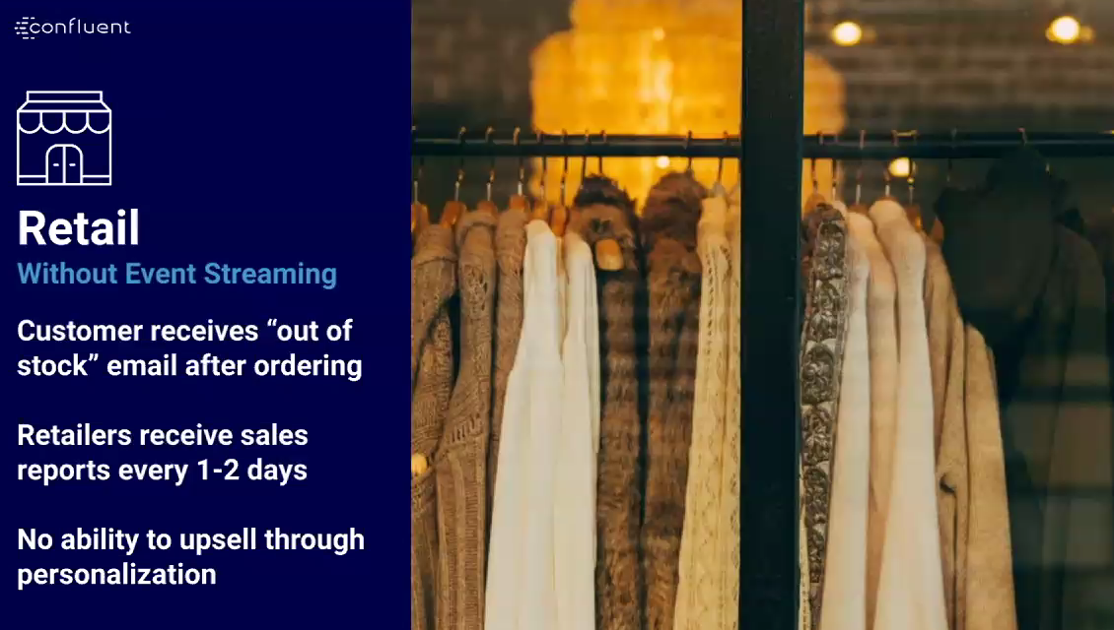

Slide 32
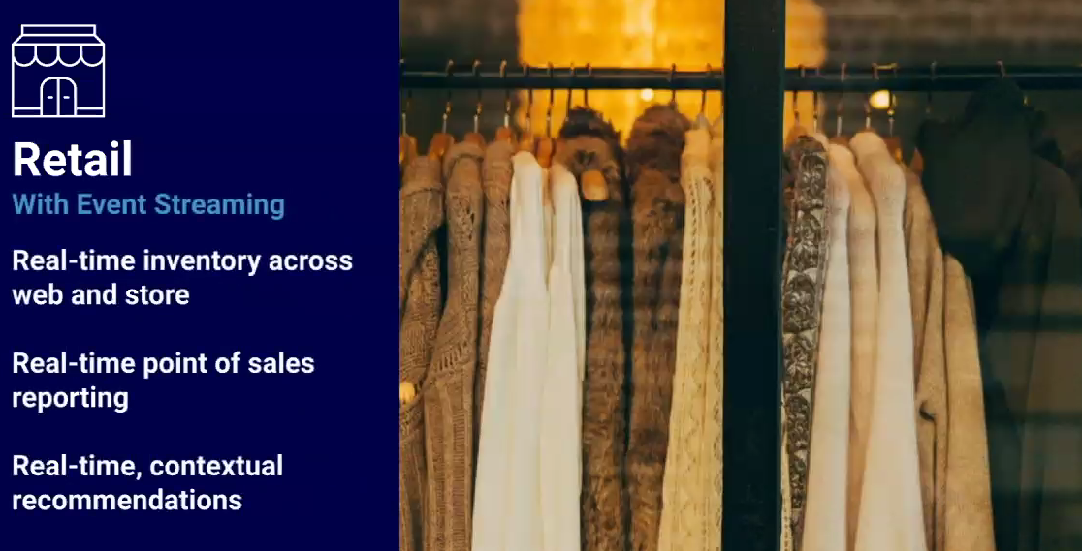

Slide 33
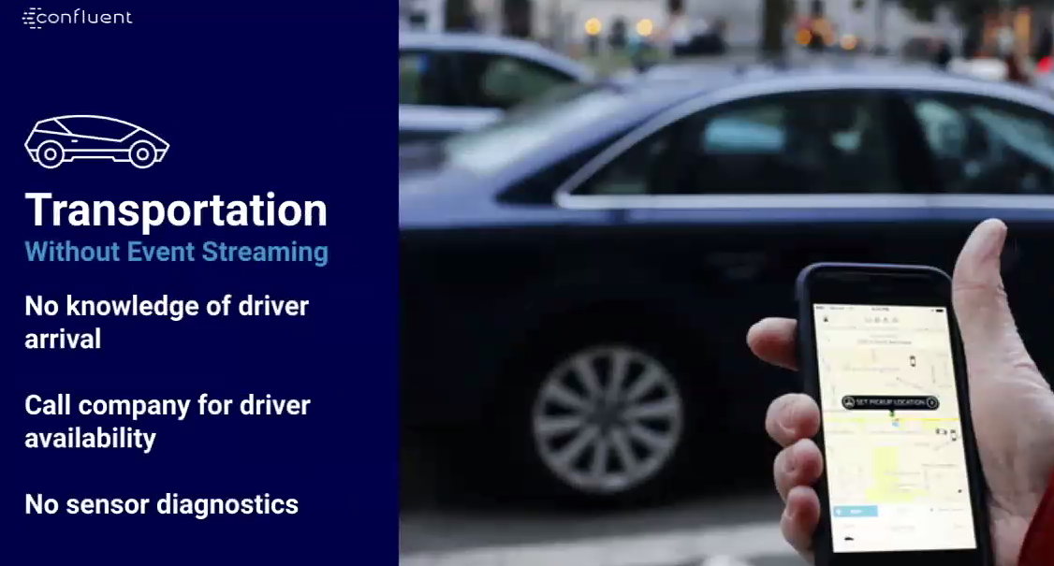

Slide 34
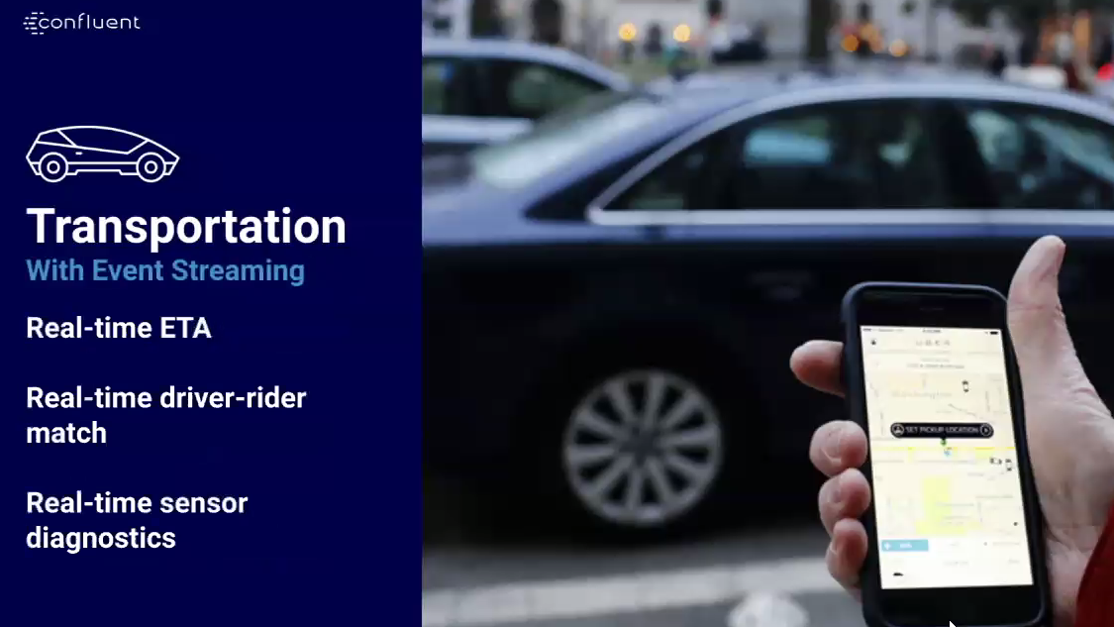

Slide 35


Slide 36


Slide 37
DEMO - 1

Slide 38
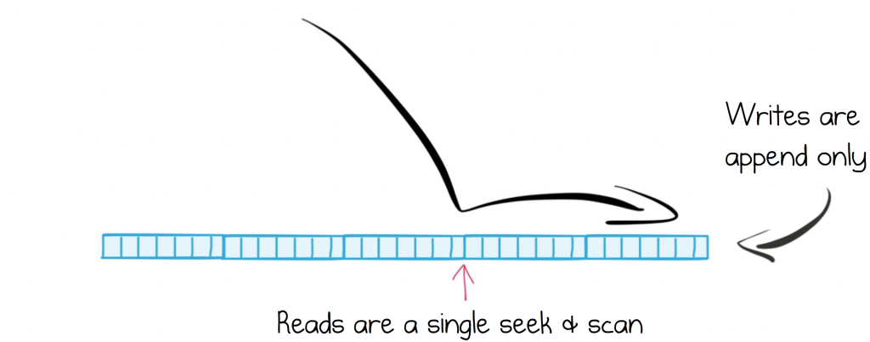
Efficient Structure for Retaining and Distributing Messages

Slide 39
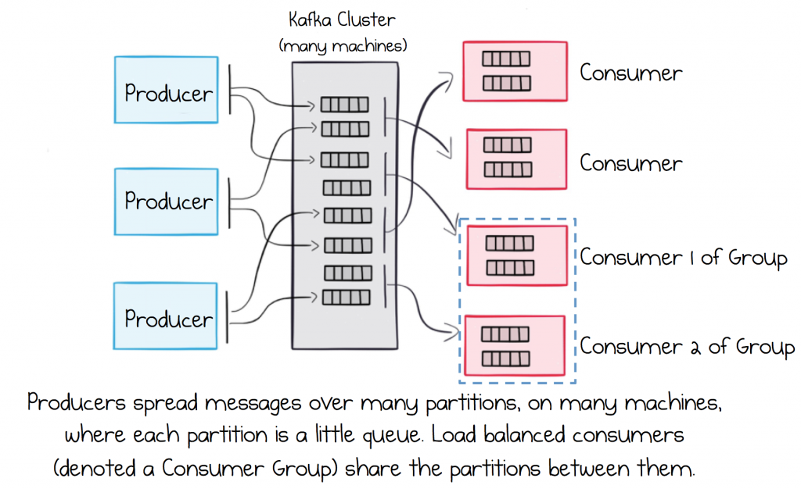
Rely on a Broker that Scales Out Linearly

Slide 40
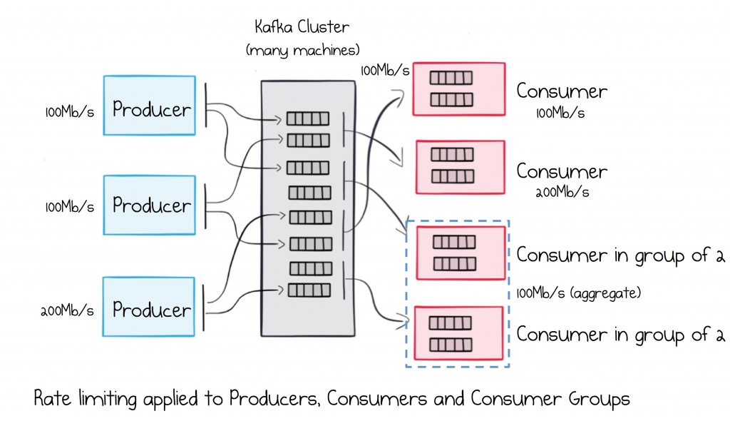
Segregate Load in Multi-Service Ecosystems

Slide 41
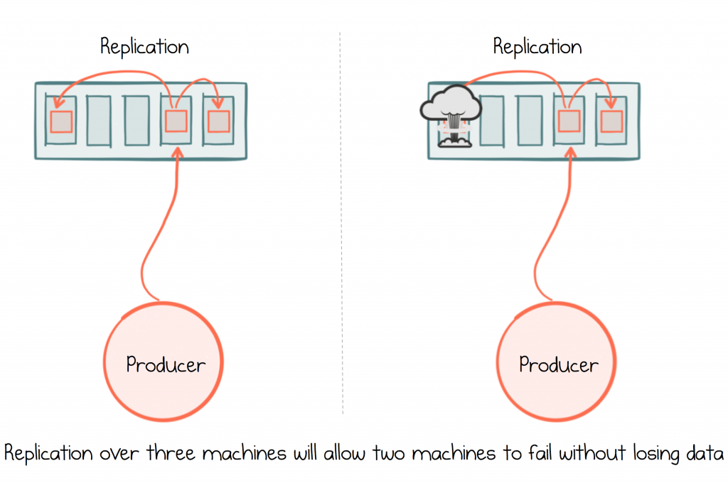
Ensure Messages are Durable

Slide 42
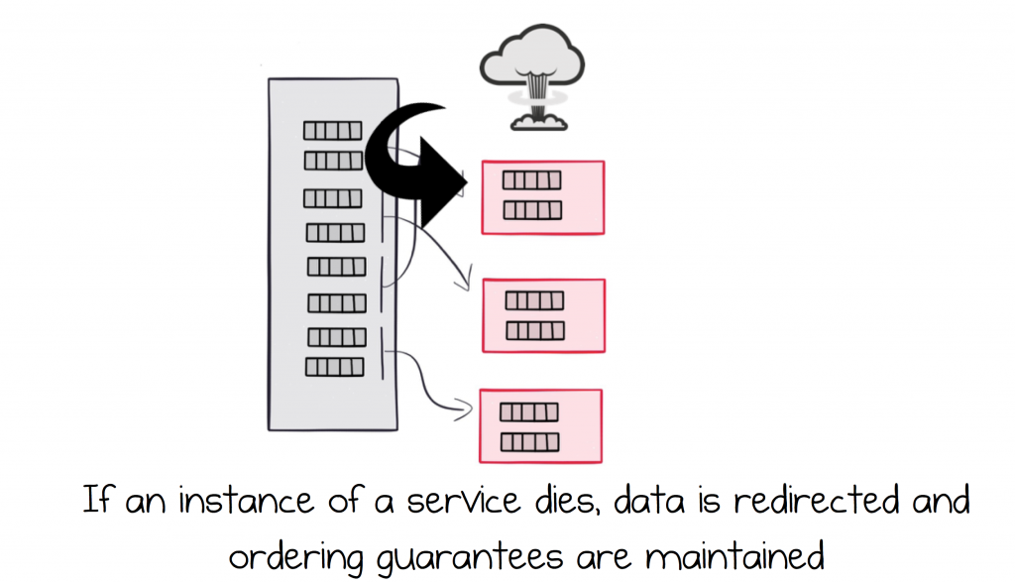
Load Balance Services and make them Highly Available

Slide 43
DEMO - 2

Slide 44
Apache Nifi
.
.

Slide 45
Bold BI
.
.

